Slide 1

AIFAEM - Implementation

Slide 2
AIF Implementation
BOR Event Linkage
Source and Target Message Design
AIF Interface Definition
Structure Mapping
AIF Action
Error Monitoring
Optional: Serialization, Indexing

Slide 3
Prerequisites
Please make sure that you have prepared the Prerequisites. They are explained in the Word Document “Rapid Prototyping Workshop - Prerequisites Day 5” in the Workshop Material

Slide 4
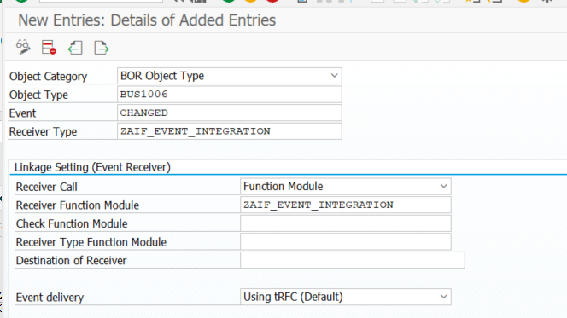
AIF Implementation – Event Linkage in SWE2
In Transaction SWE2 we can add Linkages for SAP Standard Object Events. On New Entries we just have to add an entry with Function Module "ZAIF_EVENT_INTEGRATION". The Event Types consist of technical Business Object Keys. In order to find the right Key Value, click on the F4 Help and use the Information System to Search for your Object. In this case we need BUS1006 for BusinessPartner and BUS2023 for SalesOrder
If you don´t have the AIFAEM AddOn installed yet, but AIF in general, you can also use the Source Code in the Training Materials to create your own Function module

Slide 5
AIF Implementation – General Objects - Source Message Design
For Every Event from BOR Framework the Format is the same for AIF. Please create this Structure in SE11
@EndUserText.label : 'ZAIF_EVENT_RAW'
@AbapCatalog.enhancement.category : #NOT_EXTENSIBLE
define structure zaif_event_raw {
objtype : swo_objtyp;
objkey : swo_typeid;
event : swo_event;
rectype : swe_rectyp;
}

Slide 6
AIF Implementation – General Objects - Target Message Design
In AIFAEM the Target Structure should consist of 2 SubStructures
1) Controller: Connection Information for AIFAEM to be able to send the Event to AEM. The same for all Interface
@EndUserText.label : 'ZAIF_AEM_CONTROLLER'
@AbapCatalog.enhancement.category : #NOT_EXTENSIBLE
define structure zaif_aem_controller {
rfc_dest : rfcdest;
topic : char255;
event : abap.string(0);
version : abap.string(0);
name_mapping_id : zaif_em_name_mapping_id;
uri : char255;
}
2) Data: Actual Payload of the Event as DDIC Object. Can be Event Payload only or incl. Event Standard Header. These will be provided in the upcoming Slides
Data Element with Domain CHAR10. The Name Mapping ID refers to the Database Table zaif_aem_name_ma, which you have to create (if not already provided by AIFAEM Addon) exactly with the same name, since it is hard-coded in the AddOn´s Action.

Slide 7
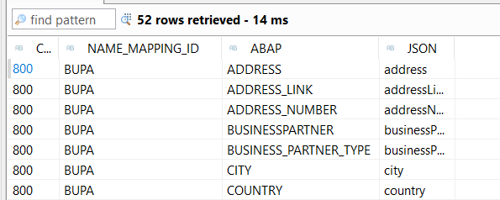
AIF Implementation – General Objects - Controller Fields – name_mapping_id
Definition of zaif_aem_name_ma
@EndUserText.label : 'Name Mapping'
@AbapCatalog.enhancement.category : #NOT_EXTENSIBLE
@AbapCatalog.tableCategory : #TRANSPARENT
@AbapCatalog.deliveryClass : #A
@AbapCatalog.dataMaintenance : #ALLOWED
define table zaif_aem_name_ma {
key client : mandt not null;
key name_mapping_id : zaif_aem_name_mapping_id not null;
key abap : char30 not null;
json : badi_char255;
}
Here you can define for which Mapping ID which ABAP name get´s mapped to a json Tag Name.
The Values needed for this Workshop are provided in zaif_aem_name_ma.xls. Please maintain the Table in SE16N and paste the entries from the Excel there.

Slide 8
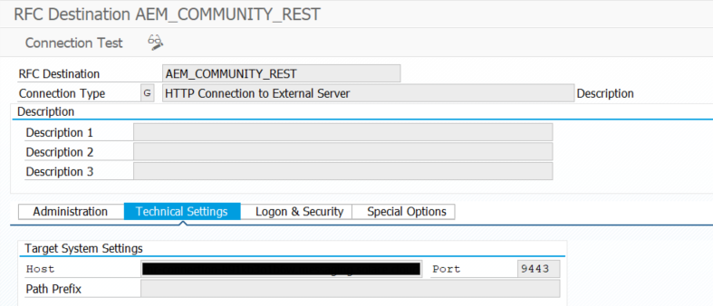
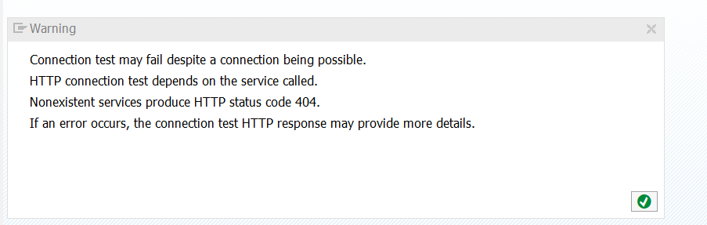
AIF Implementation – General Objects - Controller Fields – RFC_DEST
The RFC_DEST is the Destination maintained in SM59. With AIF we always use the REST Endpoint to the AEM. The assumption here is that the SM59 connection to AEM is already established. This might be done with Basic Auth or Client Certificate. One way is described here. The Connection Test should result in HTTP Error 405 Method not allowed, which is totally fine, because the Endpoint expects “POST” calls and this button sends a GET-Request.

Slide 9
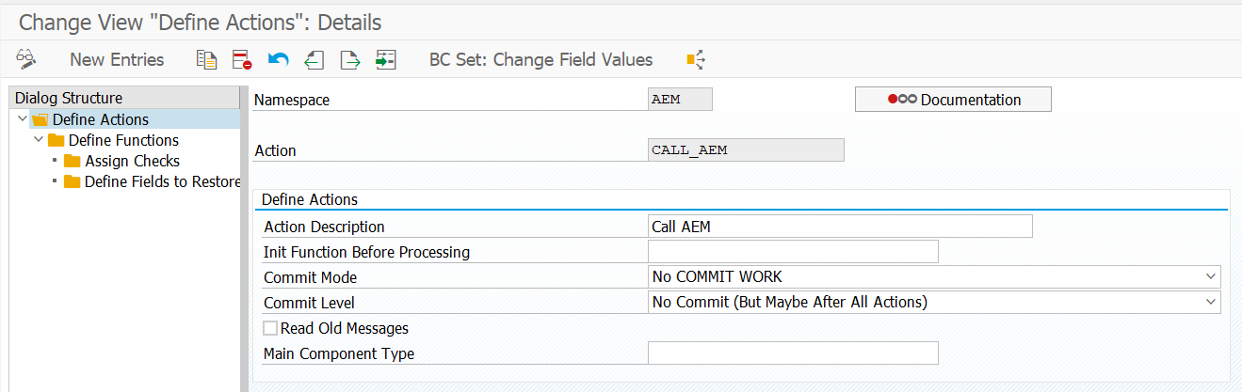
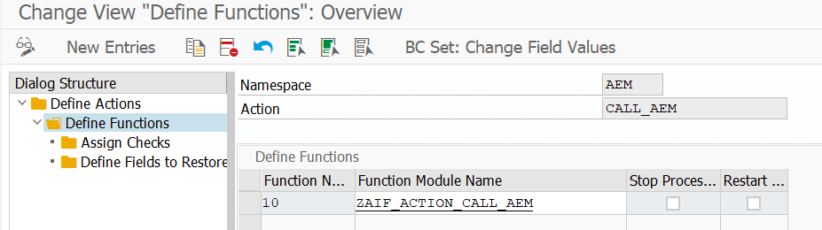
AIF Implementation – General Objects - Action Design
The AIFAEM AddOn already provides an Action Function Module for all AEM Interfaces you can use to send the Data to AEM.
You just need to customize the Action once in /N/AIF/CUST -> Define Actions and reference the Function Module
If you don´t have the AIFAEM AddOn installed yet, but AIF in general, you can also use the Source Code in the Training Materials to create your own Function module

Slide 10
AIF Implementation - BusinessPartner - Target Message Design
The DATA-Segment of the Target Structure for Business Partner is a nested Structure with Table Types in between. The Definition are added in the Training Material as Text Files. You can easily create them in ABAP Developer Studio and paste the content of the file. Please create them in this Order, because they reference each other (Table Types are described in TableTypes.txt).
zaif_em_bp_address_details
zaif_em_bp_address_details_tt
zaif_em_bp_address
zaif_em_bp_address_tt
zaif_em_bp
zaif_em_bp_tab
zaif_em_bp_data

Slide 11
AIF Implementation - BusinessPartner - Target Message Design
Resulting Target Structure:
@EndUserText.label : 'Event Message'
@AbapCatalog.enhancement.category : #NOT_EXTENSIBLE
define structure zaif_em_bp_event_message {
controller : zaif_em_controller;
data : zaif_em_bp_data;
}

Slide 12
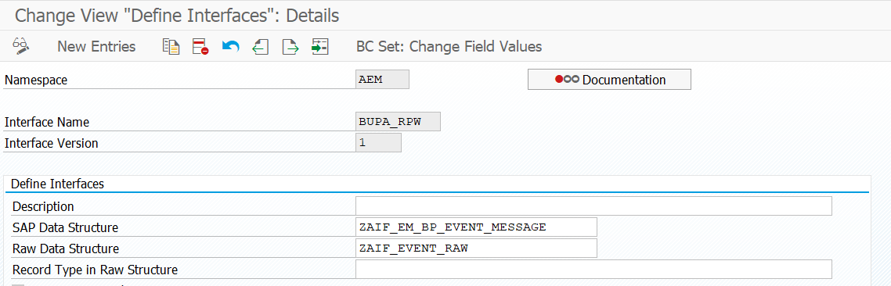
AIF Implementation - BusinessPartner - Interface Definition
Now that we have defined the Source and Target Structure, we can create the Interface. Open Transaction /N/AIF/CUST -> Define Interface and maintain the Structures here.
Interface name can be individual
Namespace should always be “AEM” for AEM-Interfaces. Only this way the Messages to AEM are free of charge. If not created yet, go one step back and to “Define Namespaces” and create AEM Namespace

Slide 13
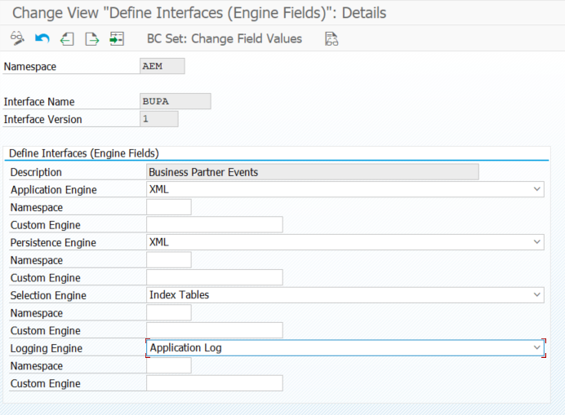
AIF Implementation - BusinessPartner - Interface Engine
In AIF we can use many kinds of Engines. We are using the XML Engine. In /N/AIF/CUST -> Additional Interface Properties -> Specify Interface Engines we need to change the Application and Persistence Engine to XML

Slide 14
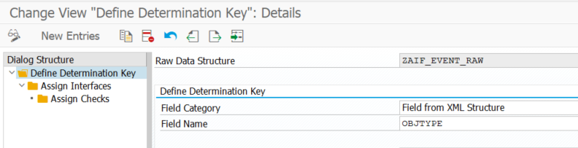
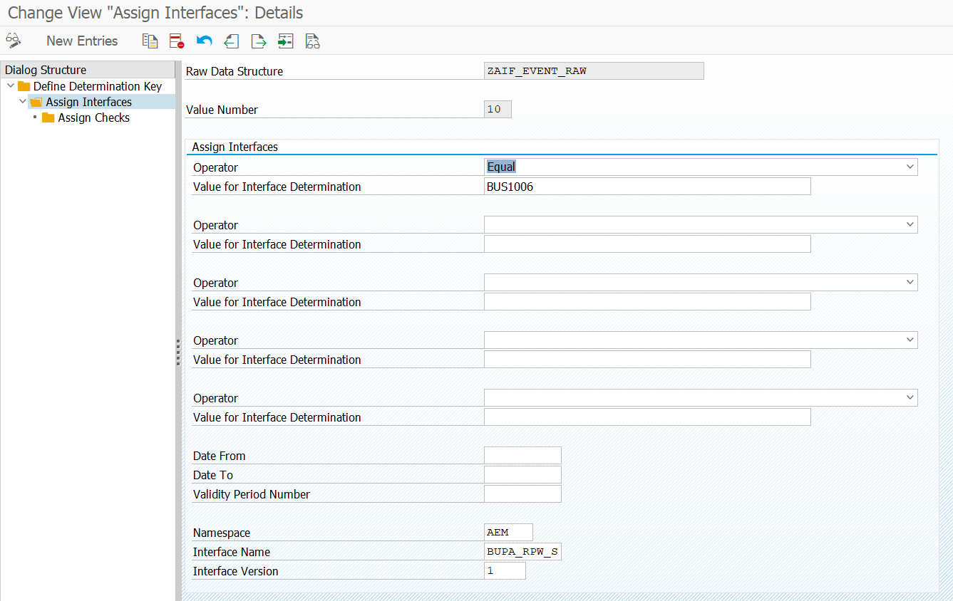
AIF Implementation – Interface Determination
Also we need to specify on what condition the AIF needs to call this interface (because the Source Structure is always the same for all Events). Therefore we need to open /N/AIF/CUST -> System Configuration -> Interface Determination -> Interface Determination For XML.

Slide 15
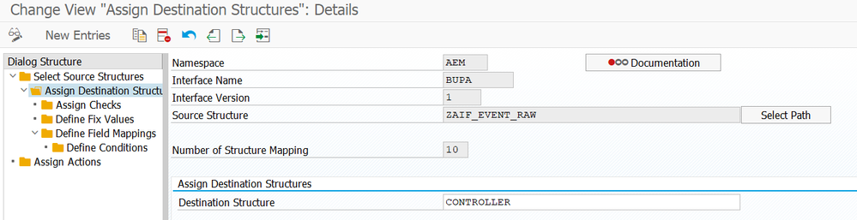
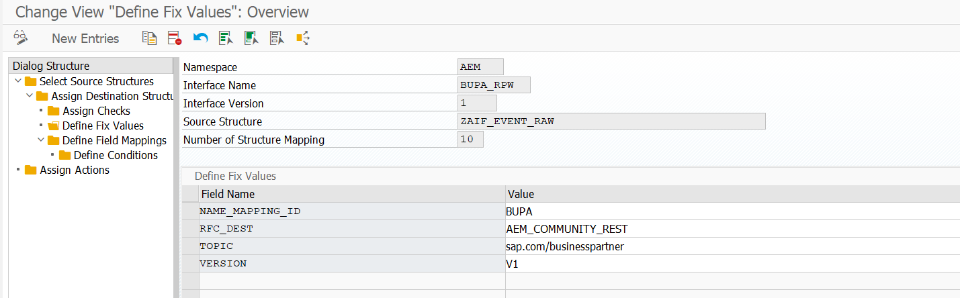
AIF Implementation – Structure Mapping - Controller
In /N/AIF/CUST -> Define Structure Mapping we can define what and how exactly needs to be mapped to our Target Structure. We only have one Source Structure: ZAIF_EVENT_RAW. The Target Structure here is Controller

Slide 16
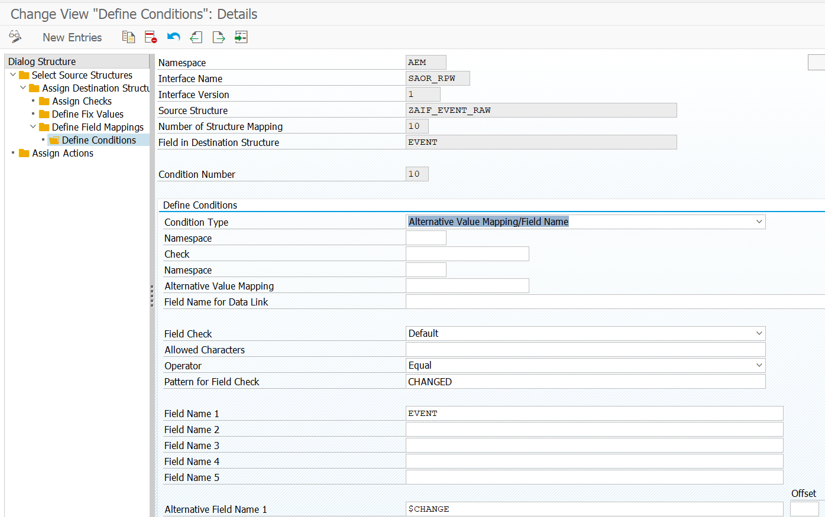
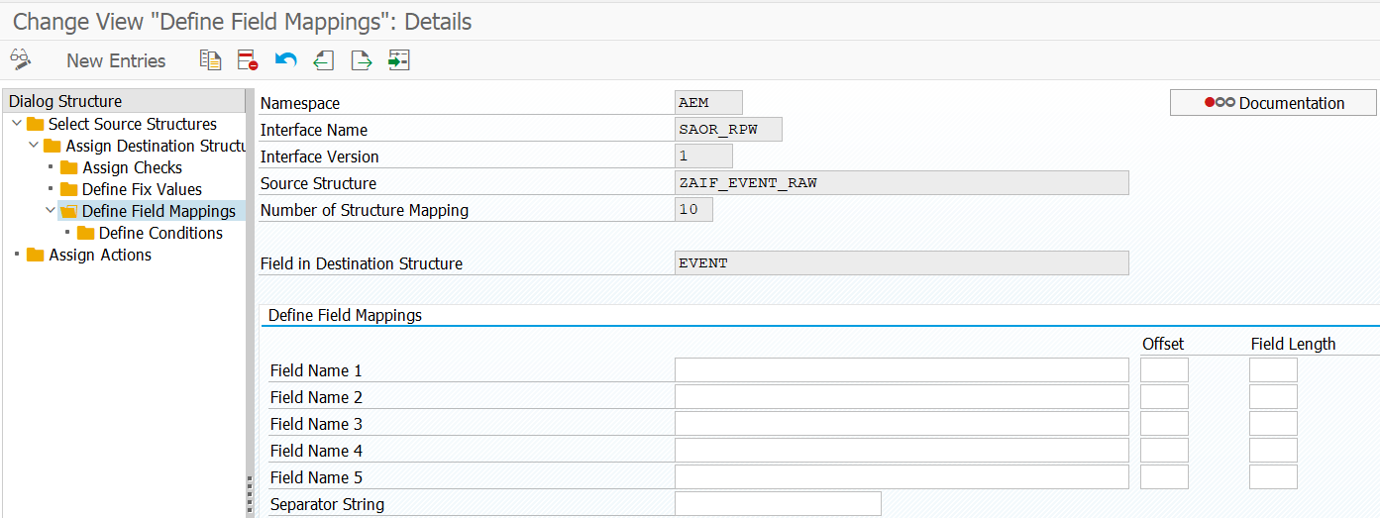
AIF Implementation – Structure Mapping - Controller
In the Field Mapping we will map different values for the event (CHANGED -> change, CREATED -> create).
The Field Mapping itself is empty In the Conditions we specify the alternative values

Slide 17
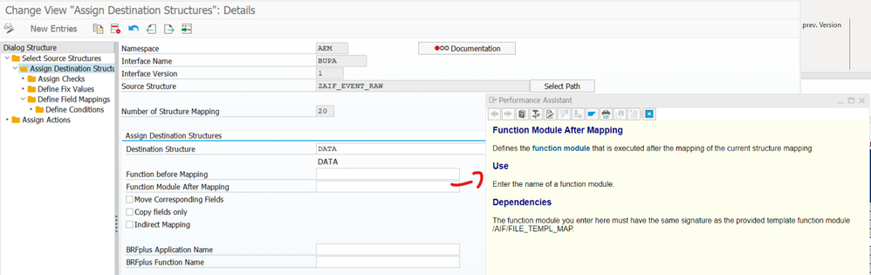
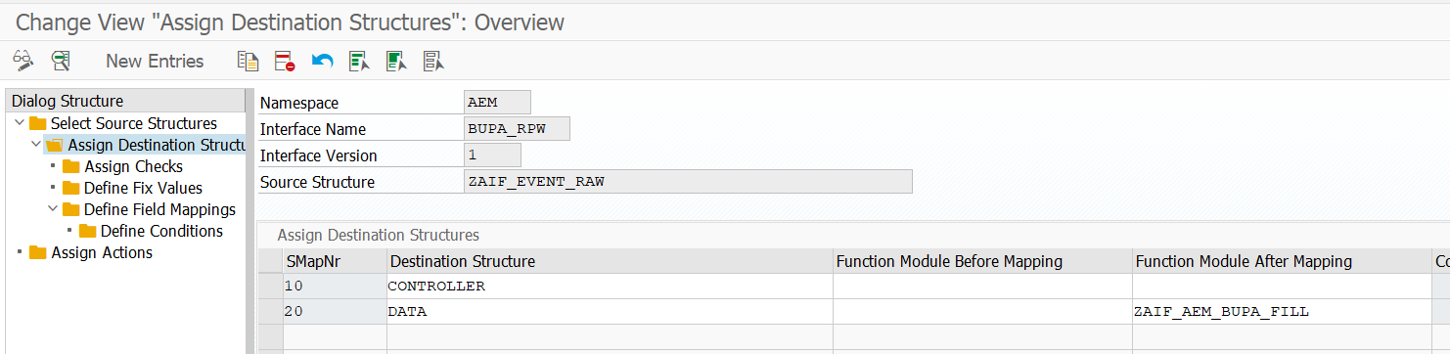
AIF Implementation – Structure Mapping - Data
In the Structure Mapping we could make use of all kinds of Functionality in AIF (Value Mappings, Condition, Checks,..). Since we need multiple fields of a few Tables, the most performant way to solve this is a Structure Mapping Function Module (copy of the Template /AIF/FILE_TEMPL_MAP). The Source Code of this Function Module Can be found in the Training Material

Slide 18
AIF Implementation – Structure Mapping – Function Module
The Structure Mapping Function Module is fetching the Data from the Database and maps it to the Target Structure. For this Workshop we have 2 Versions available:
ZAIF_AEM_BUPA_FILL: For ECC-Customers. Here you will need to create the DB View ZAIF_AEM_BUPA_V (Join Condition and Fields documented in ZAIF_AEM_BUPA_V.xlsx)
ZAIF_AEM_BUPA_FILL_S4: For S/4HANA Customers: Makes use of CDS View A_BusinessPartner (Basis for Odata API) which is already provided by SAP in S/4HANA

Slide 19
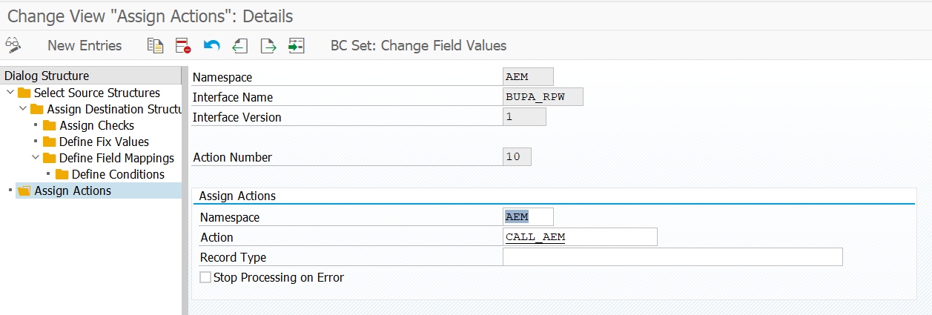
AIF Implementation – BusinessPartner Structure Mapping – Action Assignment
Last Step: Assign the Action we designed before to the Interface

Slide 20
AIF Implementation - SalesOrder - Target Message Design
The DATA-Segment of the Target Structure for Sales Order is a nested Structure with Table Types in between. The Definition are added in the Training Material as Text Files. You can easily create them in ABAP Developer Studio and paste the content of the file. Please create them in this Order, because they reference each other (Table Types are described in TableTypes.txt).
zaif_em_sa_orderschedule
zaif_em_sa_orderschedule_tab
zaif_em_sa_orderitem
zaif_em_sa_orderitem_tab
zaif_em_sa_customer
zaif_em_sa_customer_tab
zaif_em_sa_orderheader
zaif_em_sa_orderheader_tab
zaif_em_sa_salesorder
zaif_em_sa_event_message

Slide 21
AIF Implementation - BusinessPartner - Target Message Design
Resulting Target Structure:
@EndUserText.label : 'Event Message'
@AbapCatalog.enhancement.category : #NOT_EXTENSIBLE
define structure zaif_em_sa_event_message {
controller : zaif_em_controller;
data : zaif_em_sa_salesorder;
}

Slide 22
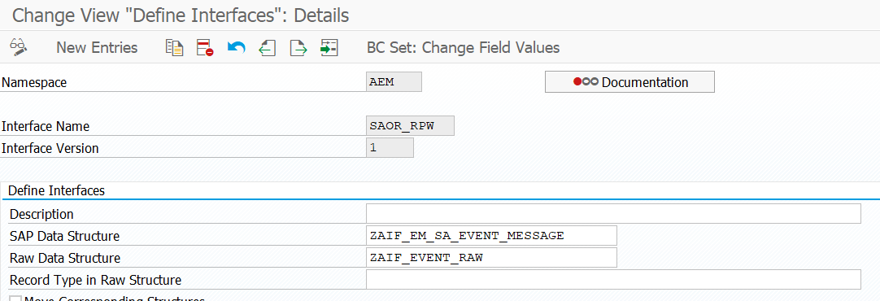
AIF Implementation - BusinessPartner - Interface Definition
Now that we have defined the Source and Target Structure, we can create the Interface. Open Transaction /N/AIF/CUST -> Define Interface and maintain the Structures here.
Interface name can be individual
Namespace should always be “AEM” for AEM-Interfaces. Only this way the Messages to AEM are free of charge. If not created yet, go one step back and to “Define Namespaces” and create AEM Namespace

Slide 23
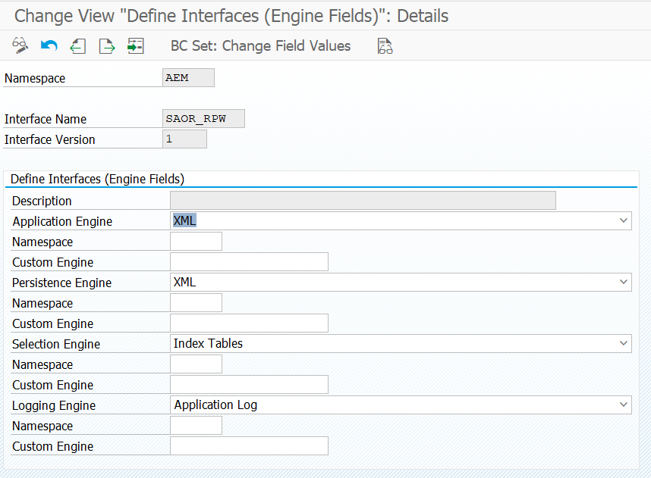
AIF Implementation - BusinessPartner - Interface Engine
In AIF we can use many kinds of Engines. We are using the XML Engine. In /N/AIF/CUST -> Additional Interface Properties -> Specify Interface Engines we need to change the Application and Persistence Engine to XML

Slide 24
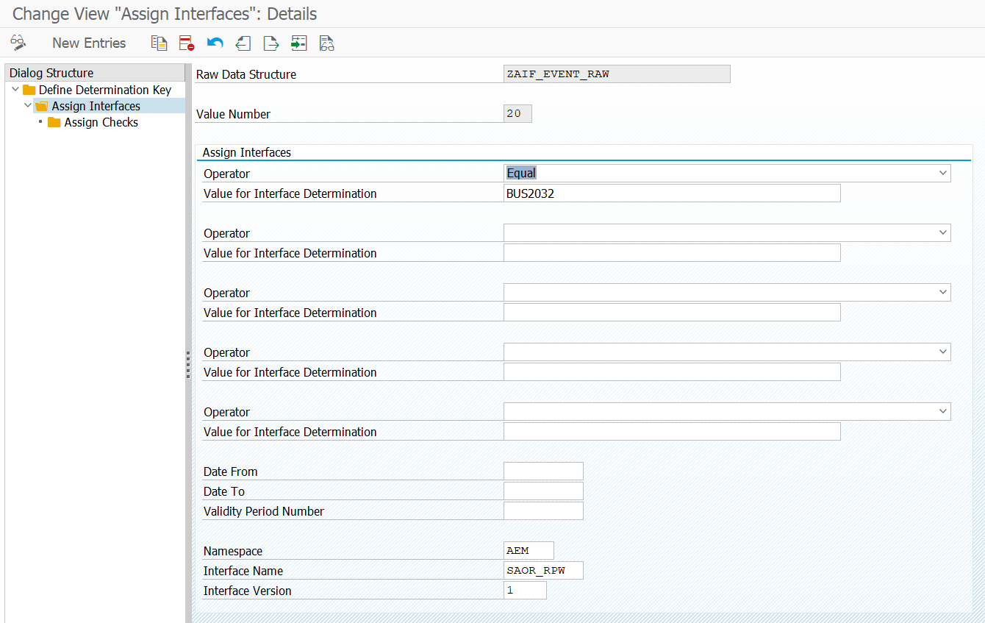
AIF Implementation – Interface Determination
Also we need to specify on what condition the AIF needs to call this interface (because the Source Structure is always the same for all Events). Therefore we need to open /N/AIF/CUST -> System Configuration -> Interface Determination -> Interface Determination For XML.

Slide 25
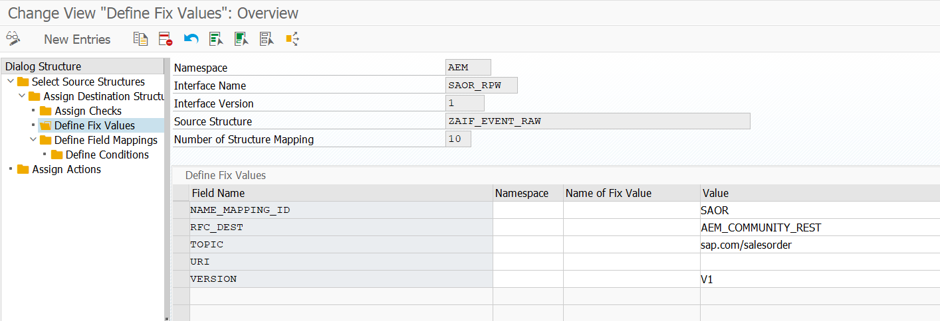
AIF Implementation – Structure Mapping - Controller
In /N/AIF/CUST -> Define Structure Mapping we can define what and how exactly needs to be mapped to our Target Structure. We only have one Source Structure: ZAIF_EVENT_RAW. The Target Structure here is Controller

Slide 26
AIF Implementation – Structure Mapping - Controller
In the Field Mapping we will map different values for the event (CHANGED -> change, CREATED -> create).
The Field Mapping itself is empty In the Conditions we specify the alternative values

Slide 27
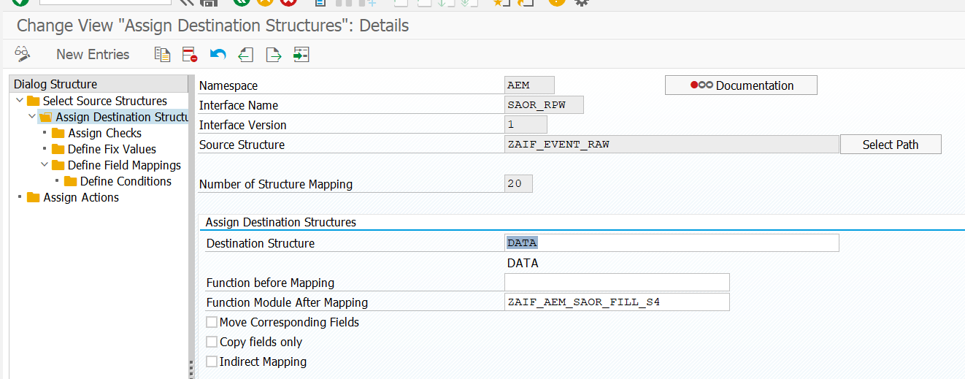
AIF Implementation – Structure Mapping - Data
In the Structure Mapping we could make use of all kinds of Functionality in AIF (Value Mappings, Condition, Checks,..). Since we need multiple fields of a few Tables, the most performant way to solve this is a Structure Mapping Function Module (copy of the Template /AIF/FILE_TEMPL_MAP). The Source Code of this Function Module Can be found in the Training Material

Slide 28
AIF Implementation – Structure Mapping – Function Module
The Structure Mapping Function Module is fetching the Data from the Database and maps it to the Target Structure. For this Workshop we have 2 Versions available:
ZAIF_AEM_SAOR_FILL: For ECC-Customers. Here you will need to create the DB View ZAIF_AEM_SAOR_V (Join Condition and Fields documented in ZAIF_AEM_BUPA_V.xlsx)
ZAIF_AEM_SAOR_FILL_S4: For S/4HANA Customers: Makes use of CDS View I_SalesOrder (Basis for Odata API) which is already provided by SAP in S/4HANA

Slide 29
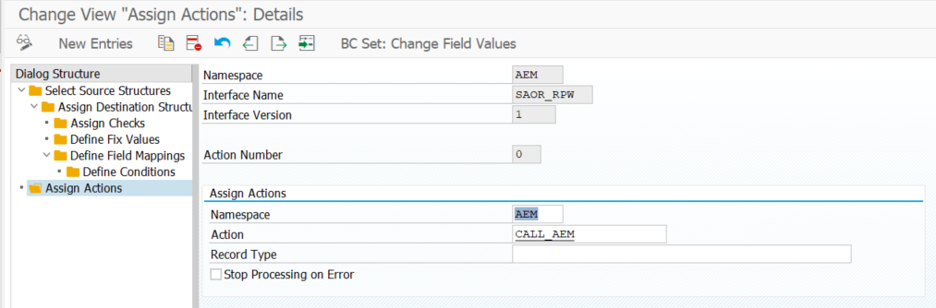
AIF Implementation – SalesOrder Structure Mapping – Action Assignment
Last Step: Assign the Action we designed before to the Interface

Slide 30
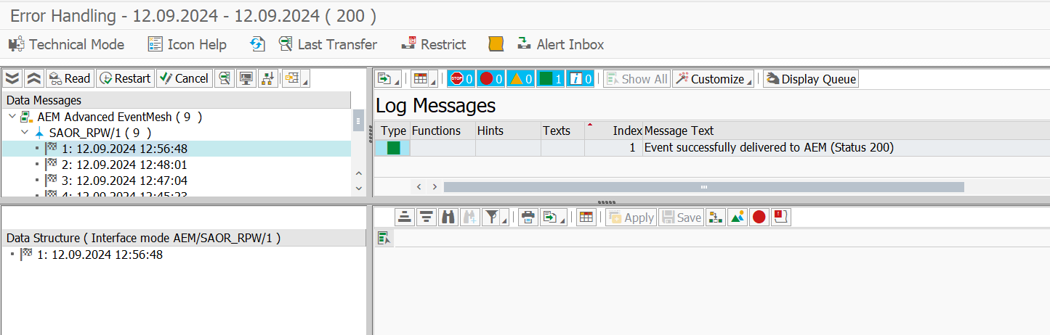
AIF Implementation – Monitoring
After Changing a Business Partner in Transaction “BP” we can monitor the Events in /N/AIF/ERR

Slide 31
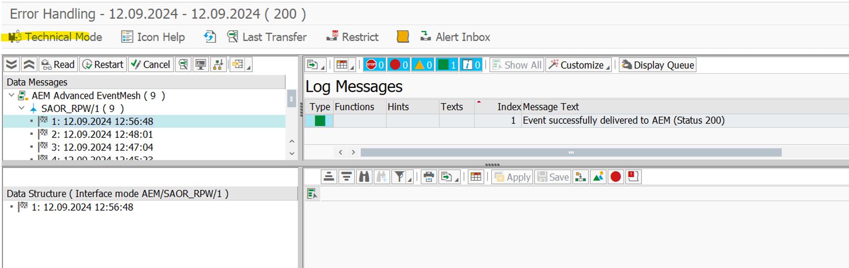
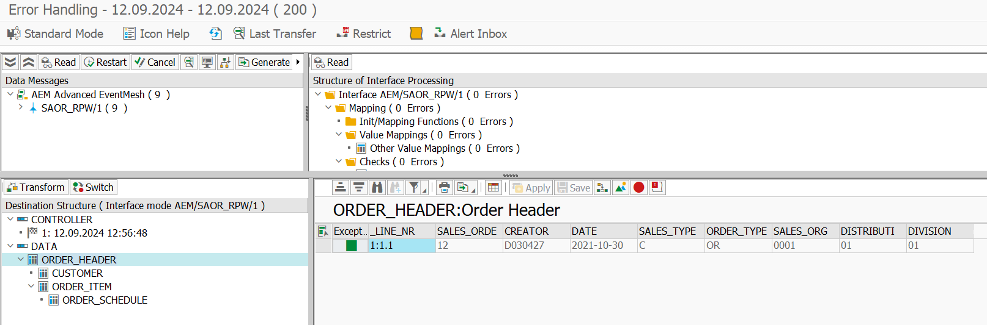
AIF Implementation – Monitoring
With the technical mode & “Transform”-Button you can see the Payload which has been delivered to AEM

Slide 32
Indexing, Serialization
These Topics are not Event-related, but generic AIF Topics. If you want to try it out, check out these Blogs:
Indexing: https://int4.com/how-to-create-a-single-index-table-in-sap-aif/
Serialization: https://community.sap.com/t5/technology-blogs-by-members/michal-s-tips-aif-3-0-serialization-parallel-processing/ba-p/13126581

